Slide 1

Care-X
Quality Medicare For All

Slide 2
57 million
Americans in rural areas lack access to medical services
Assured Access to
Quality Medicare
Is prevented by shortage of medical experts
*https://patientengagementhit.com/news/top-challenges-impacting-patient-access-to-healthcare

Slide 3

AI
HIPAA
Remote
Machine learning
Cloud
Asynchronous
Chatbots
Schedule optimization
Telemedicine
FHIR
Virtual
Records
Systems to partially solve this pain point exist, but no complete solution yet!

Slide 4

Meet Joe! A farmer from Kansas

Slide 5
2 Hours
Average travel time for Joe to reach nearest specialty medical center.
Treatment not assured
Due to shortage of experts

Slide 6
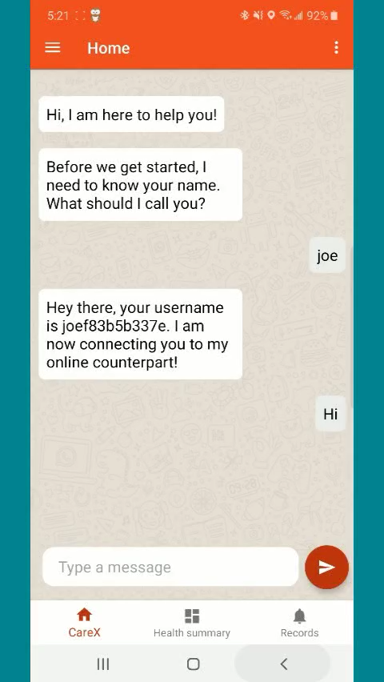
Care-X is the solution
Medical diagnostics AI Disease diagnostics - UMLS data (Over 40 years training data) Contextual by design (EMR)
Psychological support (CBT) Daily follow-ups based on patterns and recommendations
Medical experts With range of expertise From all locations With verified credentials Matched to patient Based on current requirements, location and medical history
Seamless communication powered by FHIR Easy EMR sharing by leveraging FHIR Secure data and documents Multiple platforms supported
Global scale and scope

Slide 7
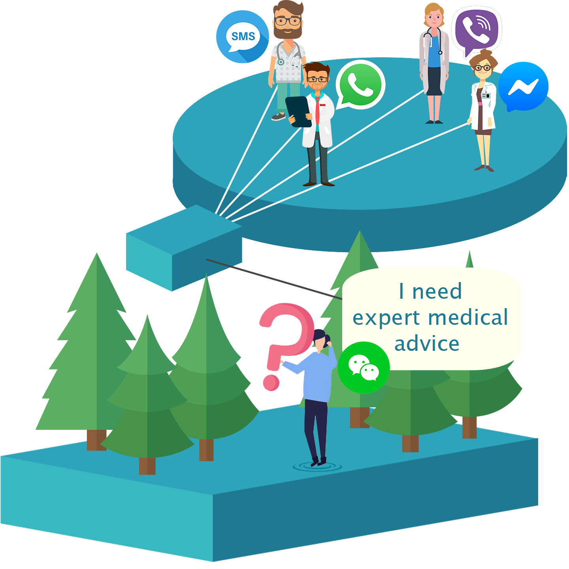
Anywhere, Anytime
Care-X is always accessible,
as its not tied to hospitals, locations, etc.
Through Any app
Care-X is accessible through all existing
communication apps*
*Currently developed for WhatsApp, FB Messenger, SMS and CareX App Easy extension to Voice calls, WeChat, Viber, etc

Slide 8
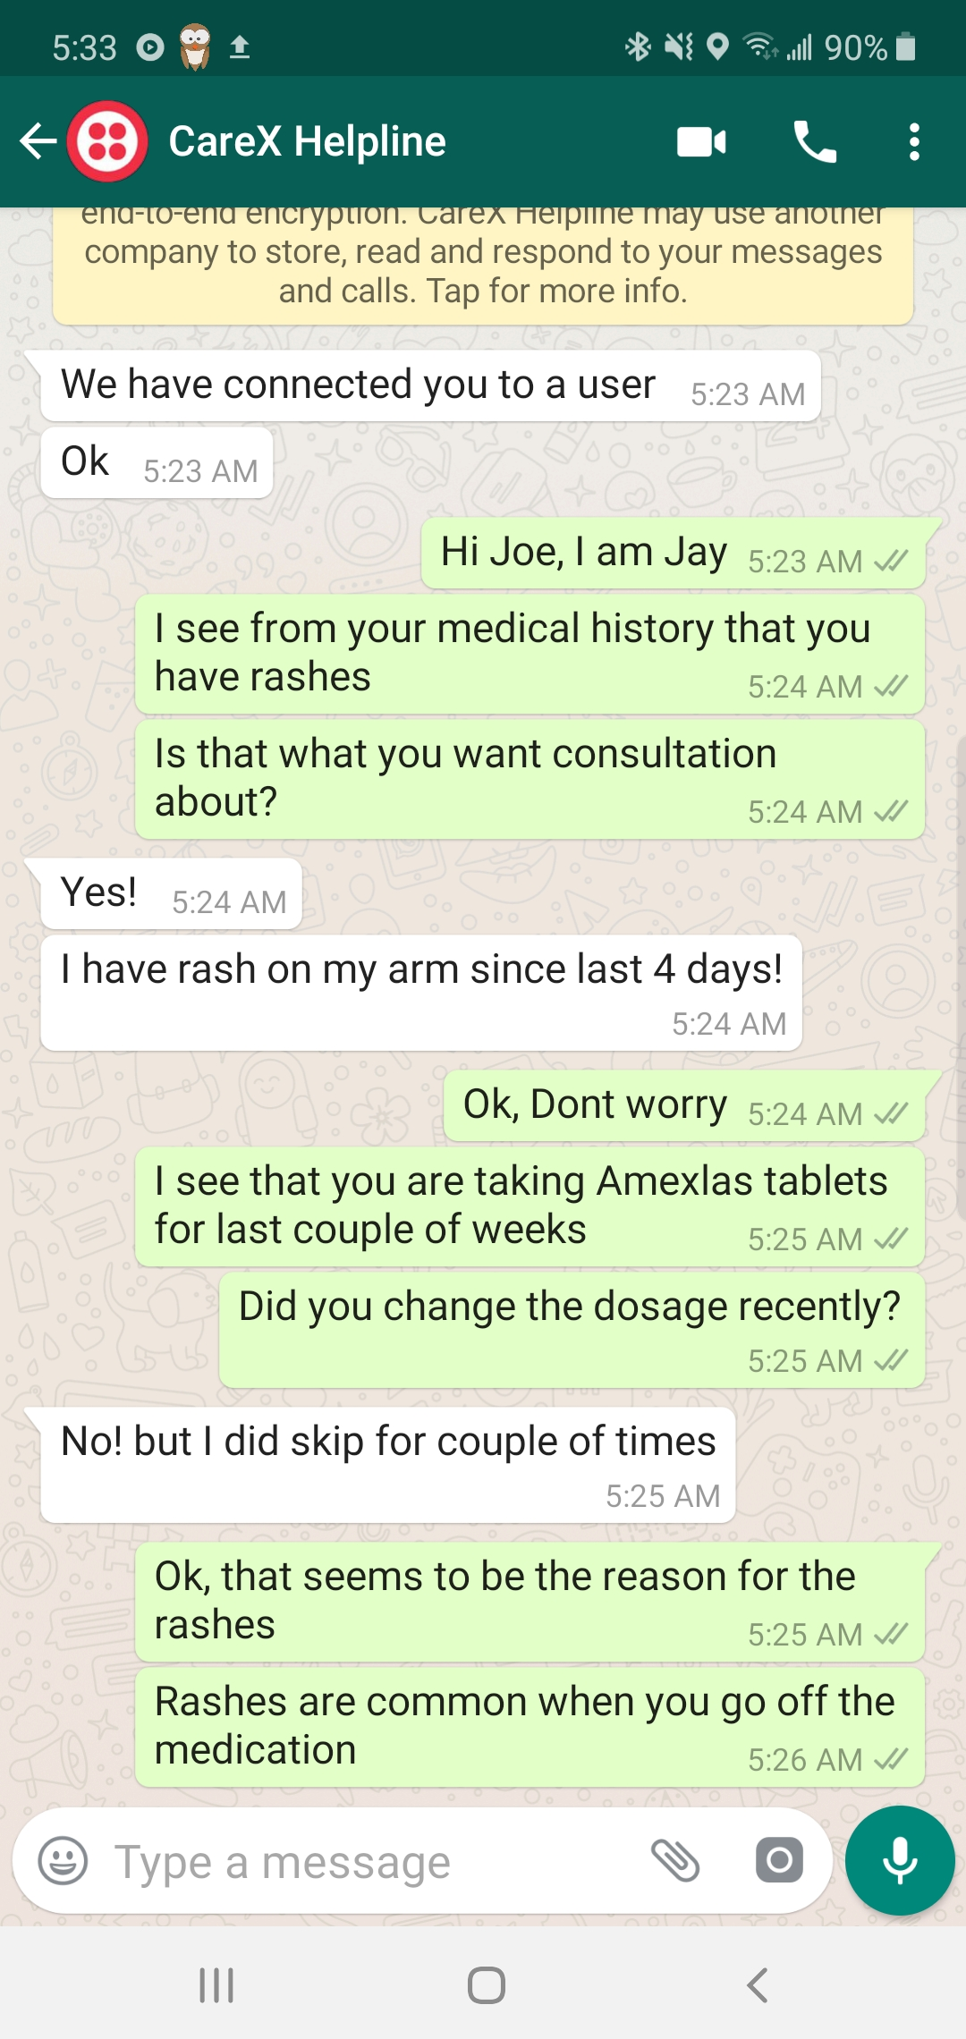
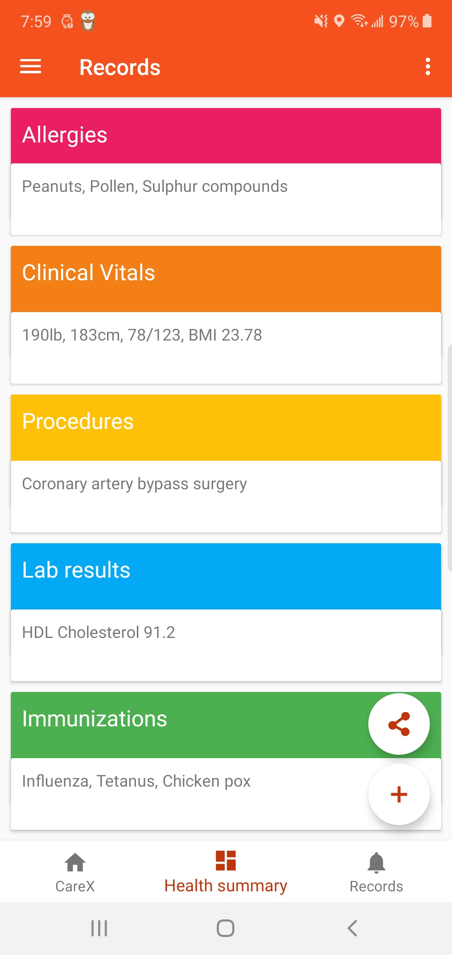
Medical expert interacting with Joe
Care-X App for EMR aggregation & analytics

Slide 9
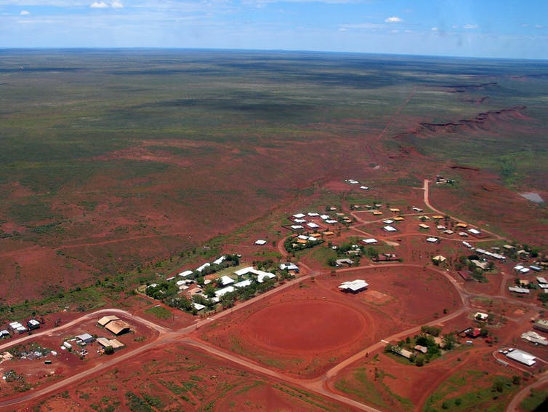

Scenario 1
Medical inclusion - Assured access to quality Medicare at affordable cost

Slide 10
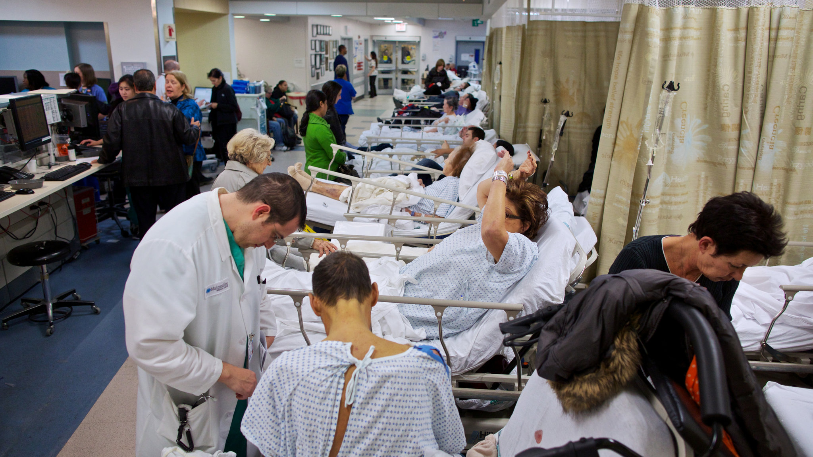
Scenario 2
Doctors utilization optimization- Allows doctors to focus on critical cases

Slide 11
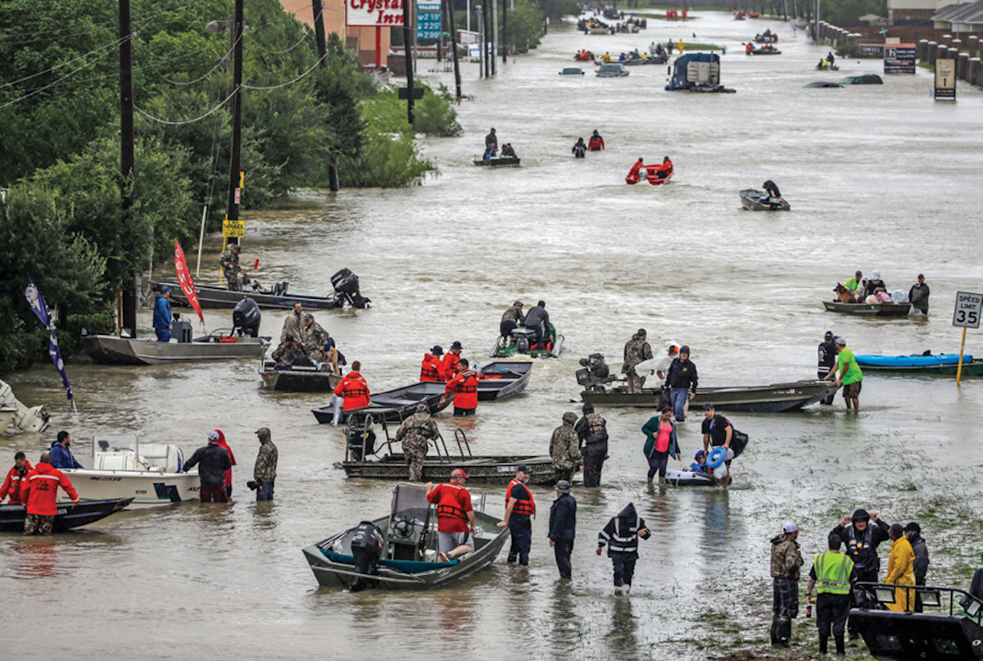
Scenario 3
Disaster response and recovery – Ensuring ready access to low cost healthcare after disasters

Slide 12









Architecture
Flask API
Chatbot engine
Disease diagnostics Engine
Psychology therapy engine
MQTT broker
EMR data analysis engine
State management DB
User management DB

Slide 13

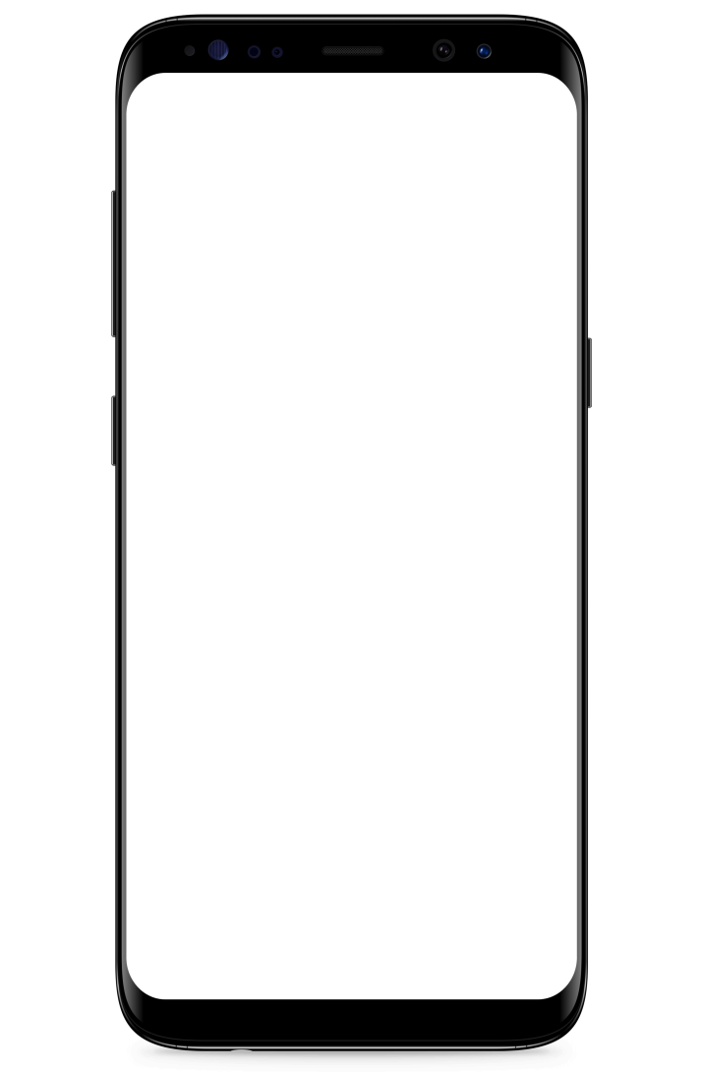
FHIR Data transfer
Care-X Server
Home Hospital
Hospitals connected to via Care-X
Care-X App

